Slide 1
Kickstarter
RWHD Final Project
Flower Yang, Qingwei Zhang, Keturah Jones
04/30/2019

Slide 2
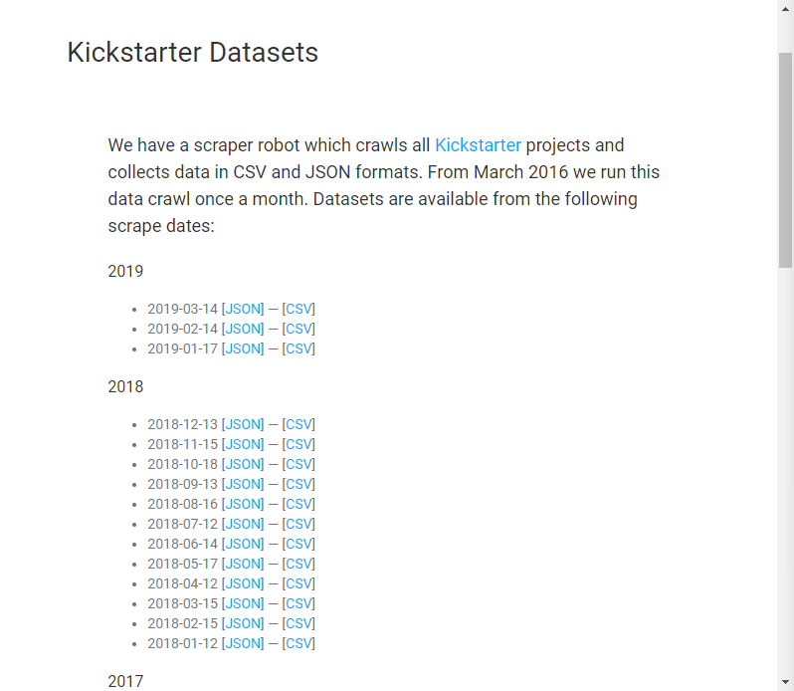
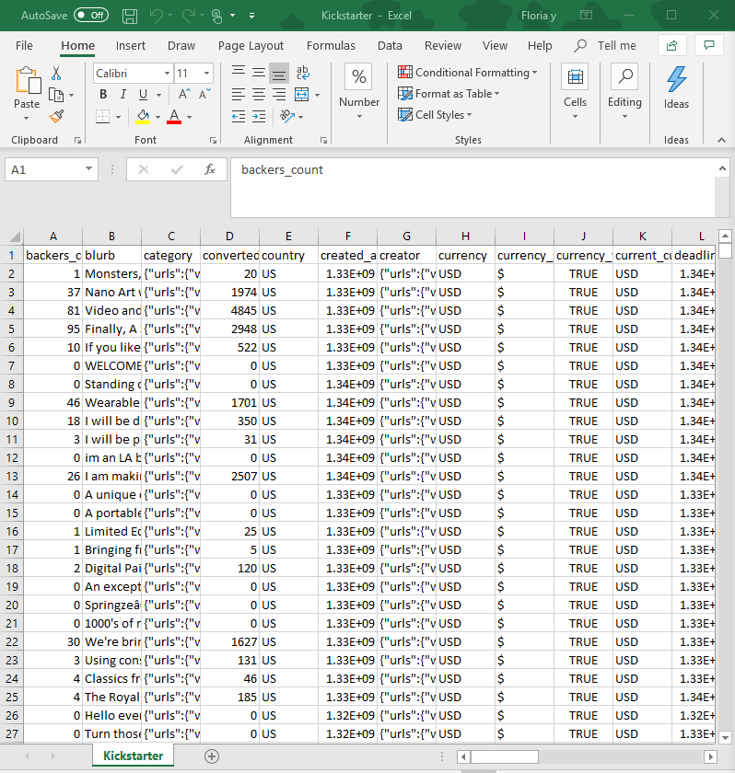

Slide 3
Data Description
Data from 2018 is used in this project. Each month contains approximately 48 to 50 csv files.
Examples of Variables:
ID : project ID, consist of numbers
Name: Project name
Blurb: Project Description
Goal: amount of the money goal to succeed the project
USD_Pledged : Actual amount in USD reached from the goal
State: success, failed, canceled, or live
7. Country & location
8. Deadline: Time of the deadline
9. Launching time
10. Backers: Number of supporters
11. Category: 15 categories of project

Slide 4
Data Pre-processing
37 columns (variables) in original dataset, of which we keep for analysis: backers count; blurb; category; country; deadline; goal; id; launched at; location; name; spotlight; staff pick; state; state changed at; usd pledged
Adding numeric labels (1-15) to represent the 15 categories of projects: art; comics; crafts; dance; design; fashion; film & video; food; games; journalism; music; photography; publishing; technology; theater

Slide 5
Descriptive Statistics
1)Geo analysis -- The whole world
2)Histogram of success across categories(defining success using general (‘state’)
3)relationship between "spotlighted"/"staff picked" and being successful
4)relationship between goal $$ and being successful
5) the number of projects in each category for every month of every year (a line plot with time on the x-axis).

Slide 6
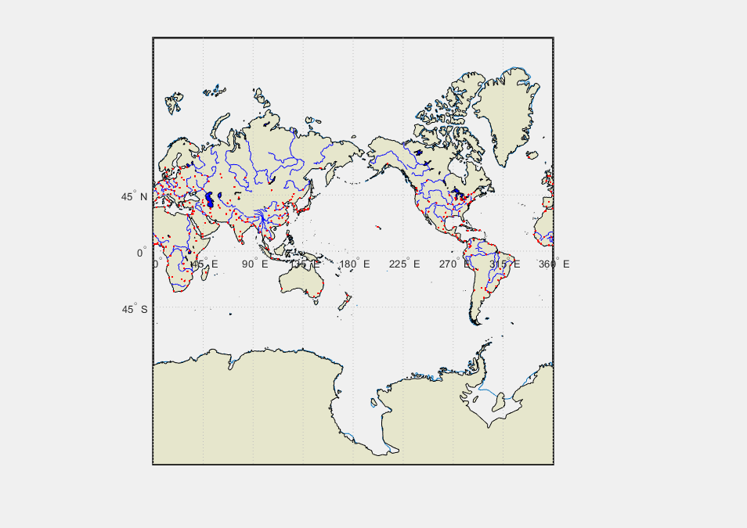
Figure and Analysis

Slide 7
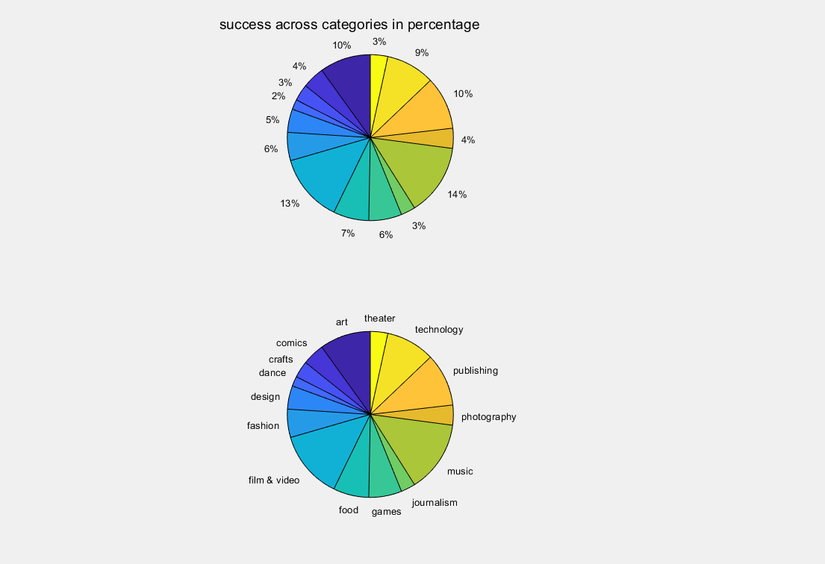

Slide 8
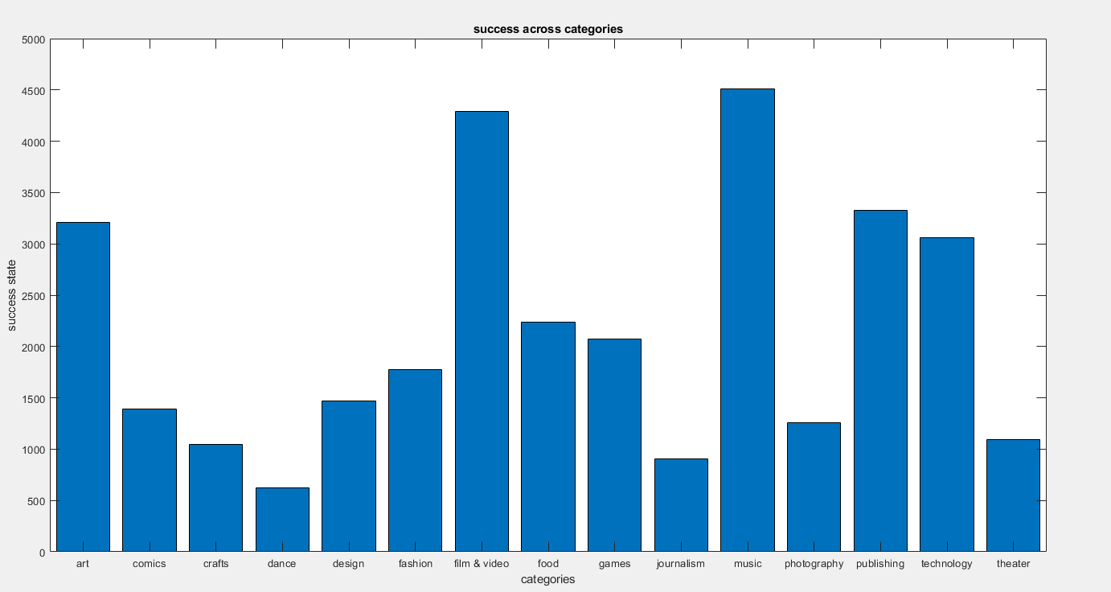

Slide 9
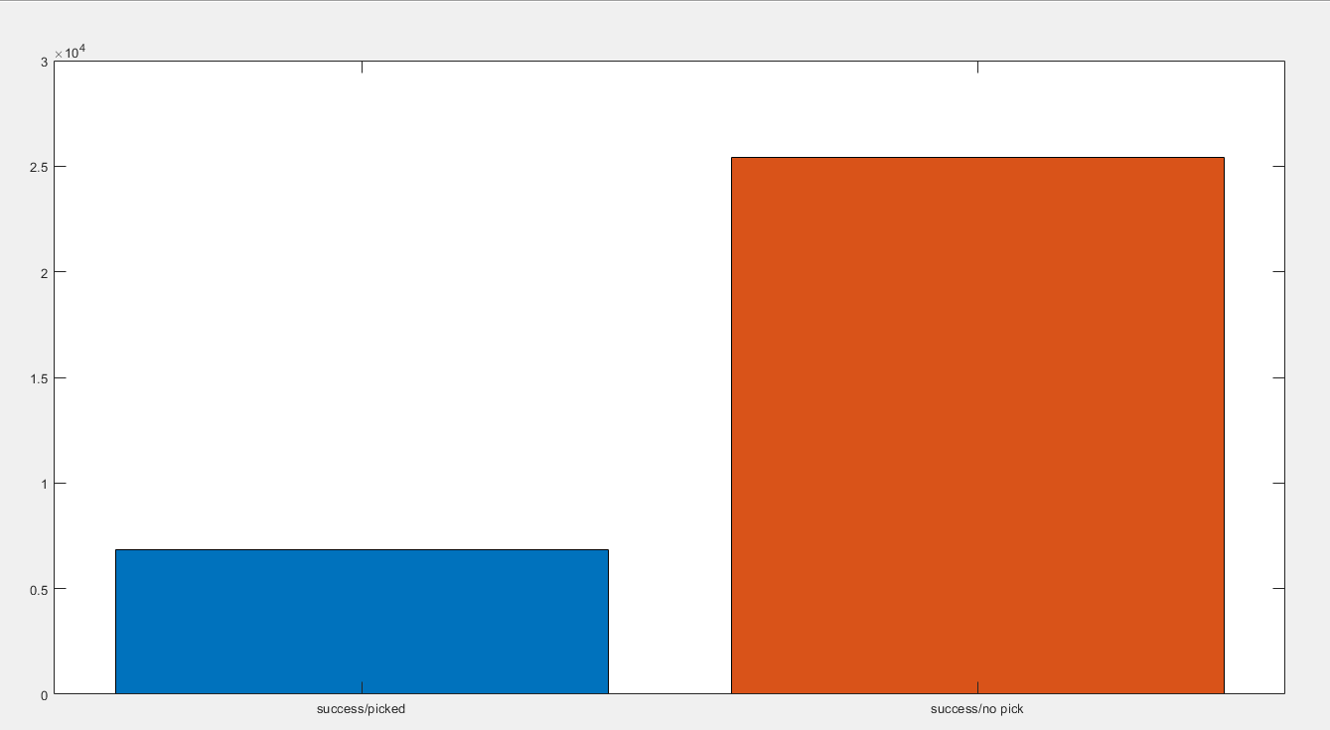
Success with ‘Staff Pick’

Slide 10
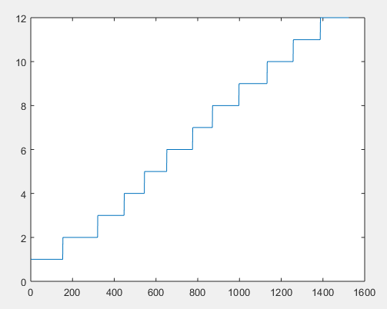
the number of projects in each category for every month of every year

Slide 11
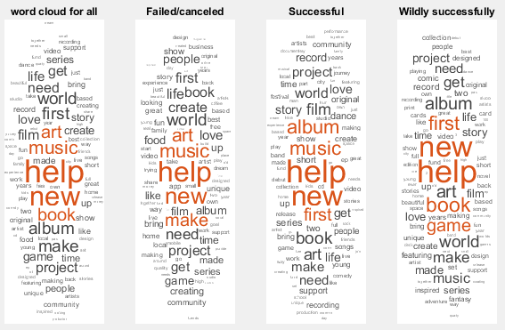
Detailed Analysis 1:
Classification of project success using project description
1) failed/cancelled projects
2) successful projects
3) wildly successful projects: exceed expected outcome by at least 20%

Slide 12
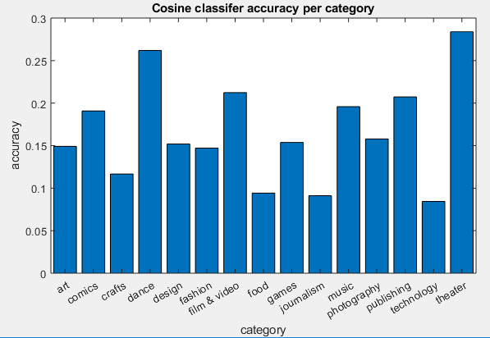
Classification using Cosine Classifier: generate the average word embedding vector for each class. Use 11 months of data as input (training data) to train a classifier, which is then used to predict the class of the remaining month.
Overall mean accuracy across categories:
0.1883

Slide 13
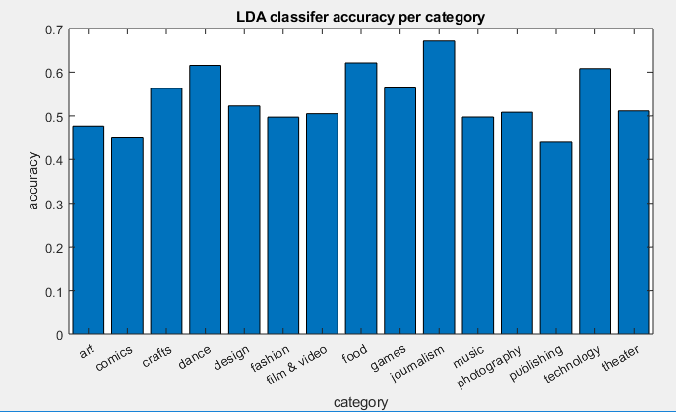
Classification using LDA classifier: use 11 months of data as training data and the last 1 month as test data.
Overall mean accuracy across categories:
0.48

Slide 14
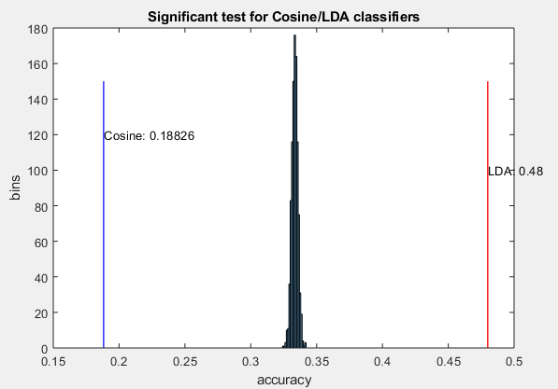
Significance Test
Cosine classifier:
Mean accuracy: 0.188
P-value: 1
LDA classifier:
Mean accuracy: 0.48
P-value: 8.5822e-15

Slide 15
Detailed Analysis 2:
How well can t-SNE, LDA and word2vec recover the categories from the blurbs?
Trained an LDA model on the blurbs, using the same number of topics as there are categories (fifteen overall).
For word2vec, calculated the average word embedding vector for each blurb
Used a subset of the dataset to train LDA model and word2vec because full dataset was too large

Slide 16
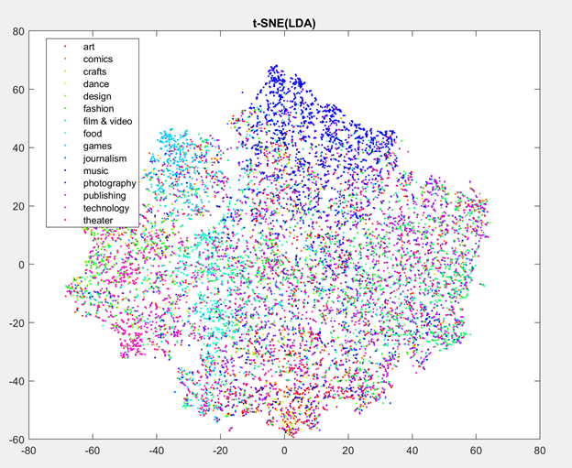
t-SNE
Produced t-SNE to reduce dimensionality of the blurb x topic mixture matrix of LDA

Slide 17
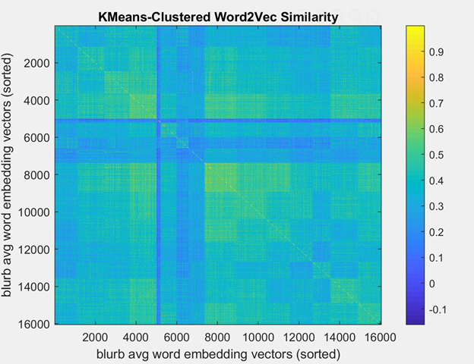
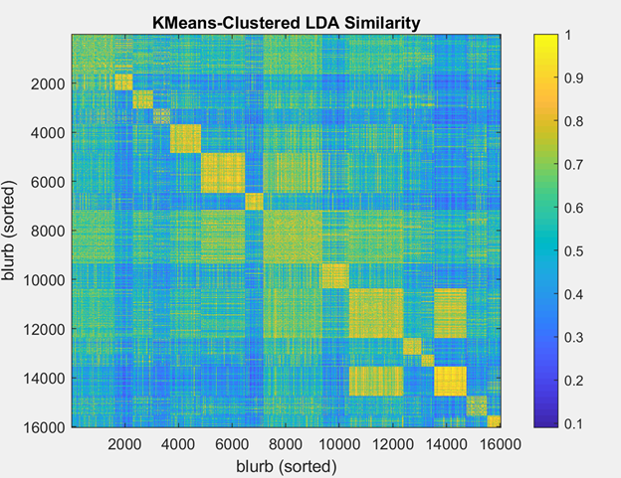
KMeans clustering

Slide 18
Jaccard Index
Calculated true overlap of actual categories and predicted categories (from kmeans) for both LDA and word2vec
Randomized actual categories and calculated overlap of that result and predicted categories 1000 times.

Slide 19
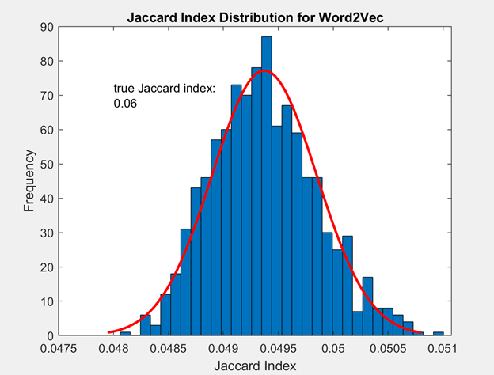
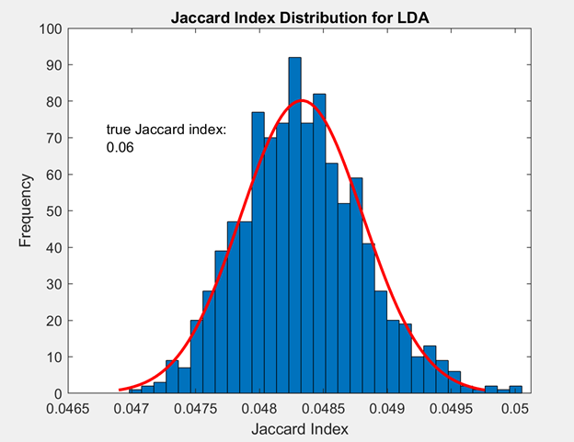
Jaccard Index Distribution Histograms

Slide 20
Solo Analysis: more classifiers
Use the time difference between deadline and launching time to classify success status
Calculate the mean time diff. for the three classes;
Use 11 months of data to train the LDA classifier;
Use the remaining one month of data as test data;
Repeat;
Calculate accuracy.
Accuracy = 0.4119
P-value = 6.8294e-12

Slide 21
Solo Analysis: more classifiers
Use the number of backers to classify success status
Calculate the mean number of backers for the three classes;
Use 11 months of data to train the LDA classifier;
Use the remaining one month of data as test data;
Repeat;
Calculate accuracy.
Accuracy = 0.4247
P-value = 6.9781e-12

Slide 22
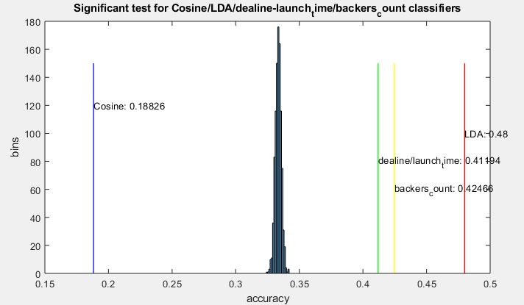
Solo Analysis: Significance

